Slide 1
The Playgarden at Almaden Lake
…inspiration into a reality!
Notes:
Hope this presentation inspires you to see the possibilities
And to join us in turning this inspiration into reality

Slide 2
Collaborative
Effort
Notes:
Project started as a collaboration between the City and the County.
The District 10 Council office got involved and asked the Community if they wanted to partner on this once-in-a-generation opportunity
Support was overwhelming
The Rotary Club of Almaden Valley stepped up to be the fiscal agent
Through their Endowment fund.
And the Parks Department agreed to delay the project
so the community could fundraise,
and worked with the contractor, MIG, to develop concept designs to support the effort.

Slide 3
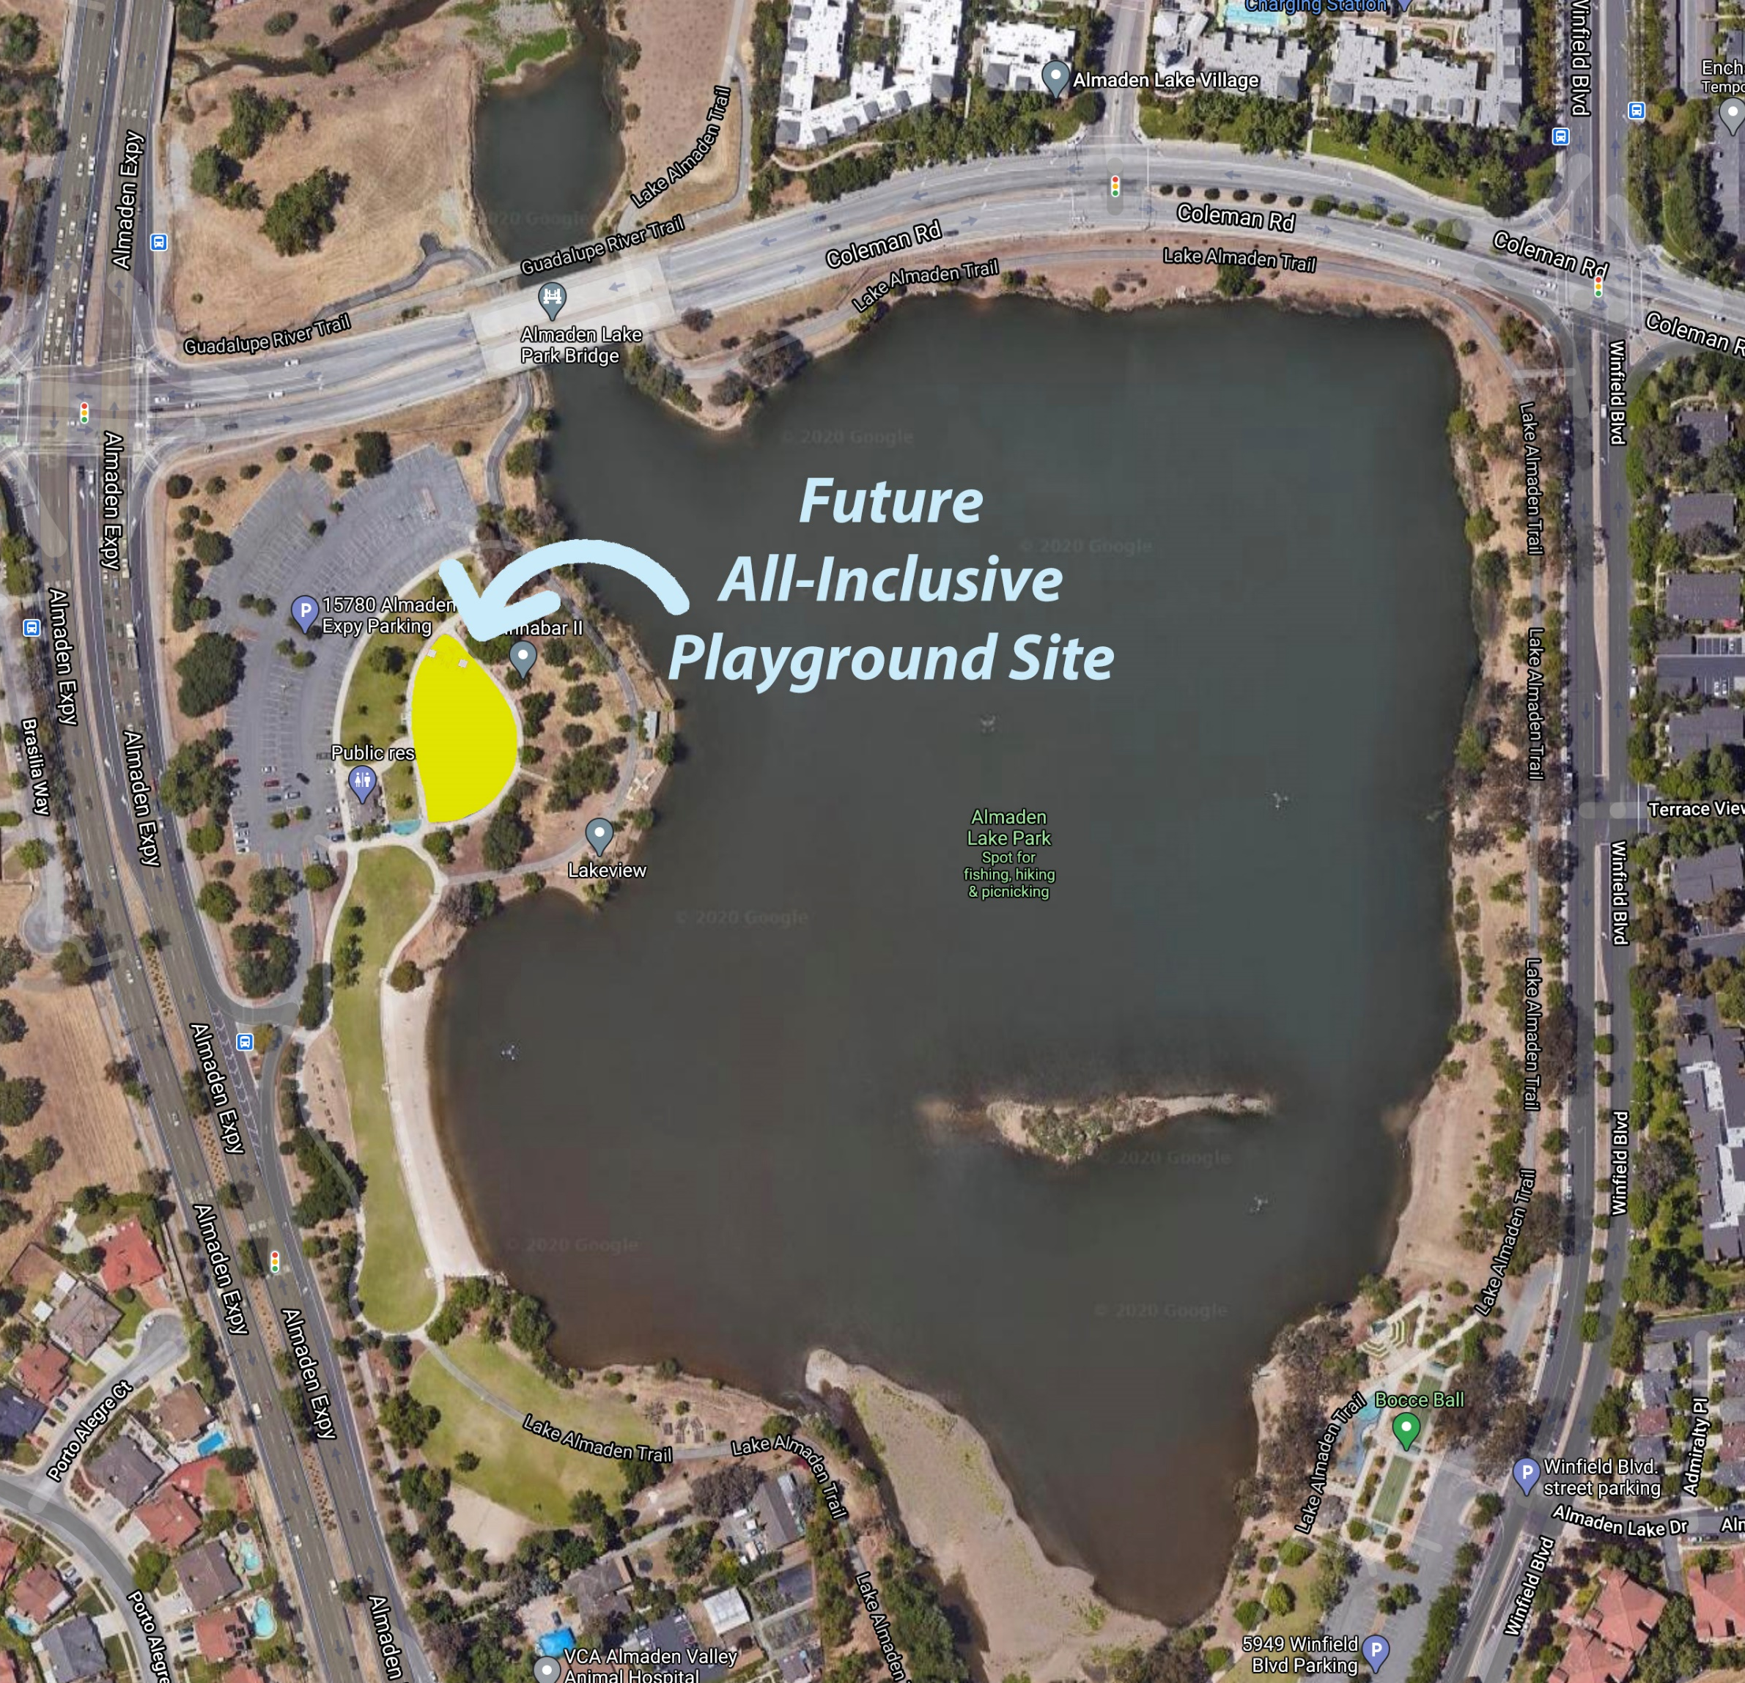
All-Inclusive Playground Grant
Current Design
Santa Clara County awarded the
City of San José with a matching AIP grant.
Grant Amount from SCC: $671,250
Matching Contribution by CSJ: $671,250
Total Project Budget: $1,342,500
Notes:
The grant from the County, and the match from the City give us a base project of $1.3M. MIG has already designed that project and it is ready to be constructed.
The upper portion is referred to as the ‘tot lot’
And the lower portion is referred to as the ‘youth lot’
As you can see, the climbing structure in the youth lot will be replaced
Which was a popular feature before it was removed
It was at the end of its life and became unsafe
And the climbing structure in the youth lot will remain
They will remove the climbing structure in the tot lot
And add some new all-inclusive play features.
NOTICE the brown color? That is the same bark that is there now.
Not very “inclusive” as wheel chairs and seniors find it difficult to navigate
But it meets the minimum ADA requirements
and is all that the current budget allows.

Slide 4
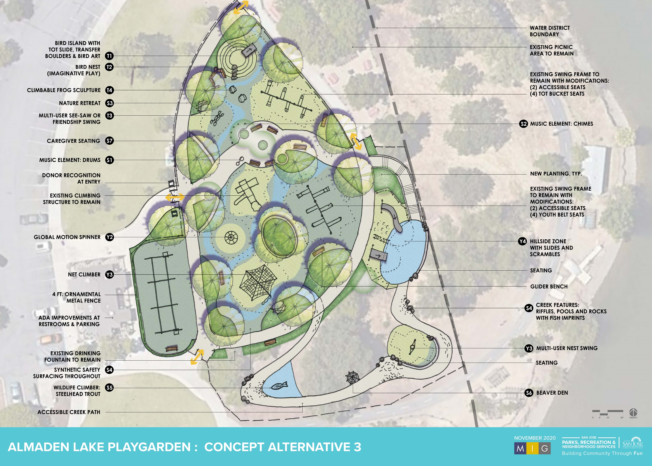
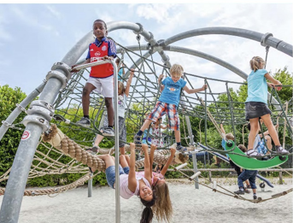
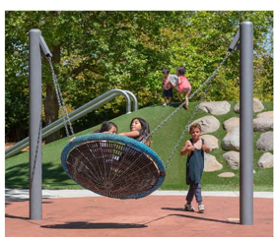
Possibilities beyond budget constraints
Net Climber
Nest Swing
Notes:
With your help, we can imagine possibilities beyond budget constraints
Notice the colored ground design?
That is resilient surfacing that is much better for wheel-chairs
The blue is made to look like a river running through the Playgarden
The tot lot has significant upgrades
with a hill/slide feature
a bird nest
There is a zip line with inclusive seating
And we can take advantage of the lower area and the natural hillside
To create a nature play area with two hillside slides
And more resilient surfacing

Slide 5
Notes:
Here are a few inspirational drawings of:
The birds nest and hill-slide in the tot lot
Along with a climbing sculpture

Slide 6
Notes:
Hillside Slide area –
Notice the blue surfacing made to look like a pond
Slides will be concrete for those with cochlear implants (in ears).

Slide 7
Notes:
Zip line with two zipping options for traditional zip line set up (person in blue in the background) and a sitting option (red seat in the foreground)

Slide 8
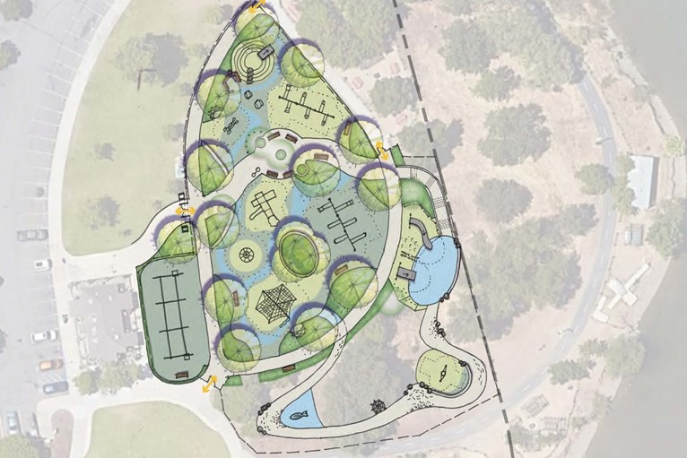
Estimated Budget & Fundraising Goals
Playground Current Design | Playgarden + Nature Area
Estimated Budget: | $1.3 M | Estimated Budget: | $5.0 M
Add’l Fundraising: | $0 ----- | Add’l Fundraising: | $3.7 M
Notes:
If we do nothing, we will have a few new features added to the current playground and it will be better than it is now (replacing some of the equipment and add back the climbing structure).
If we dream big and build an amazing Playgarden, we need to raise $3.7M

Slide 9
Snapshot of Additional Amenities & Features
Playground Current Design |  | Playgarden + Nature Area
Estimated Budget: | $1.3 M | Estimated Budget: | $5.0 M
Add’l Fundraising: | $0 ----- | Add’l Fundraising: | $3.7 M
 | Amenities Dependent on Amount of Additional Contributions
Tanbark Surfacing | Resilient Safety Surfacing
Chain Link Fencing | Tubular Steel Fencing
Small Spinner | Medium Spinner
 | Zip Line
 | Nature Play Area
 | Hillside Slide Zone
 | Additional Musical Play Elements
 | Shade Structures/Shade Sails
 | New Restroom Building
Notes:
Instead of bark we get resilient surfacing
Instead of chain-link fencing we get nicer fencing like what is around most of our playgrounds
A larger spinner
And the additional features we talked about earlier
We even get a new all-inclusive bathroom
So a parent with an able-bodied child and a child in a wheelchair can take both children into the stall to take care of the family’s needs.

Slide 10
Your Gift to the Playgarden Once-in-a-Generation Investment in the Park
# of Gifts: | Giving Level: | What role will you “play”? (Insert Your Name Here)
1 | $1,000,000 & above
2 | 500,000 – 999,999
4 | 250,000 – 499,999
8 | 100,000 – 249,999
10 | 50,000 – 99,999
12 | 25,000 – 49,999
25 | 10,000 – 24,999
Multiple | 9,999 & under
Notes:
There are opportunities for people and businesses to support this vision at all levels, and while we can't yet commit to exact benefits, such as naming rights for parts of the playgarden, we are absolutely working to incorpoate recognition for large donors into the physical playgarden. Hasn't been designed yet.
Who in your network might be able to give at these levels? We would love introductions or leads that we can reach out to.
Point about scalability of the plans.

Slide 11
How will YOU commit to the Playgarden?
Notes:
We’re looking for people to donate and people who will reach out to their network and fundraise for this project

Slide 12
Contact Information Visit www.PlaygardenALP.org for more details
Rotary Club of Almaden Valley
info@avrcendowment.org
www.AVRCendowment.org
Council District 10 – City of San José Michele Dexter
Policy Analyst & Community Relations michele.dexter@SanJoseCa.gov
100% of donations go towards the Playgarden at Almaden Lake.
The AVRC Endowment is a 501(c)(3) charitable organization and contributions are tax-deductible to the extent permitted by law.
Federal ID #: 77-0165040
Notes:
Donations will be made to the Almaden Valley Rotary Club Endowment. They are a 501c3 and you will get a receipt for your taxes.

Slide 13
Thank you!

